Slide 1

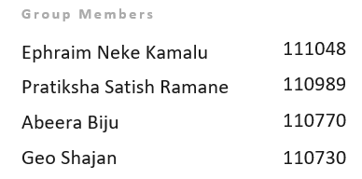

MINI-PROJECT 3 · QUALITY LOSSES & PREDICTIVE QUALITY
Predicting Injection-Moulding Defect Types from Process Data
A multi-label, leakage-aware quality predictor for the ProBayes warpage-shell dataset
Dataset: SKZ / Fraunhofer IPA — ProBayes (2022) ·
564 cycles · 7 defect types · 2 materials · 334 features

Slide 2
MOTIVATION
Knowing a Part Is Scrap — After Measuring It — Is Too Late
Overall Equipment Effectiveness = Availability × Performance × Quality
Availability
Performance
A part is scrap when any quality feature is out of spec
Inline scale, thermal camera, and vision system only flag defects after the part is made — material, energy, and cycle time are already lost
The valuable move: anticipate the defect from process signals and recommend a fix before scrap is produced
Mini-Project 1 — done
Mini-Project 2 — done
Quality
This project — predictive quality

Slide 3
THE DATA
A Real Moulding Line, Deliberately Pushed to Make Good and Bad Parts
564
47
334
Cycles / Parts
Experimental Settings
Raw Features
9
2
Data Sources
Materials (PP, ABS)
Inputs — Process Data (used)
Labels — Inline Quality Sensors (excluded)
Machine cycle values (EUROMAP 77)
The settings varied in the experiments
Temperature-control units, dosing, drying, environment
Vision camera (dimensions), thermal camera, scale
These generate the 7 defect labels we predict
Using them as inputs = leakage → deliberately removed

Slide 4

APPROACH
A Leakage-Free Pipeline, Evaluated the Honest Way
01
02
03
Process Data Only
Feature Build
Honest Split
Drop the 3 quality sensors; keep machine, settings, temperature, dosing, drying
Scalars used directly; time-series summarised by mean/std/min/max → 564 × 241
Group 5-fold CV holds out whole experiments — test on unseen settings
04
05
Per-Defect Models
Counter-Action
Baseline, logistic regression, random forest, gradient boosting
Turn each prediction into a set-point recommendation
Metrics: ROC-AUC, PR-AUC, balanced accuracy and F1 — per defect and macro-averaged (positives are rare, so accuracy alone would mislead).

Slide 5
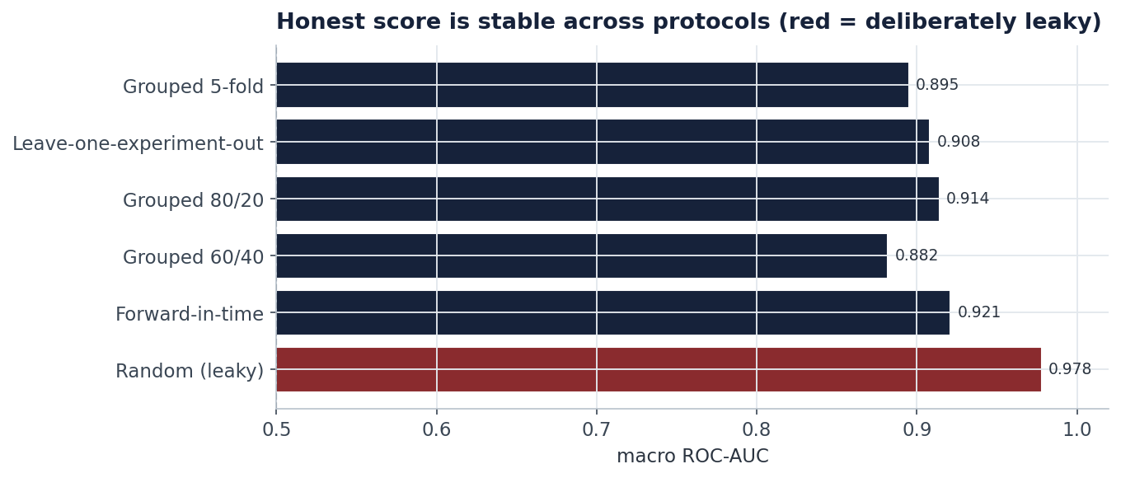
KEY FINDING
The Honest Score Is 0.895 — and It Holds Across Five Protocols
0.895
0.978
Honest score — held-out experiments, stable everywhere
Random split — leaky, inflated (we do NOT report this)
Same number across 80/20, 60/40, leave-one-out and forward-in-time.

Slide 6
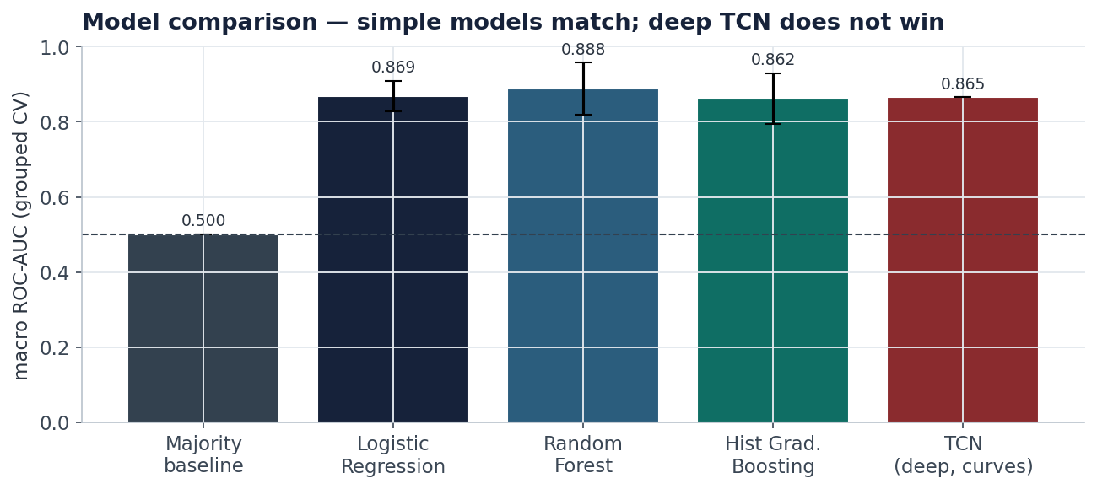
MODEL COMPARISON
Simple Models Match Each Other — and a Deep TCN Does Not Win
Random Forest edges other learners, but all three classical models cluster tightly. The deep Temporal Convolutional Network (TCN) does not outperform them at this dataset size — a reminder that more complexity is not always better with 564 cycles.

Slide 7
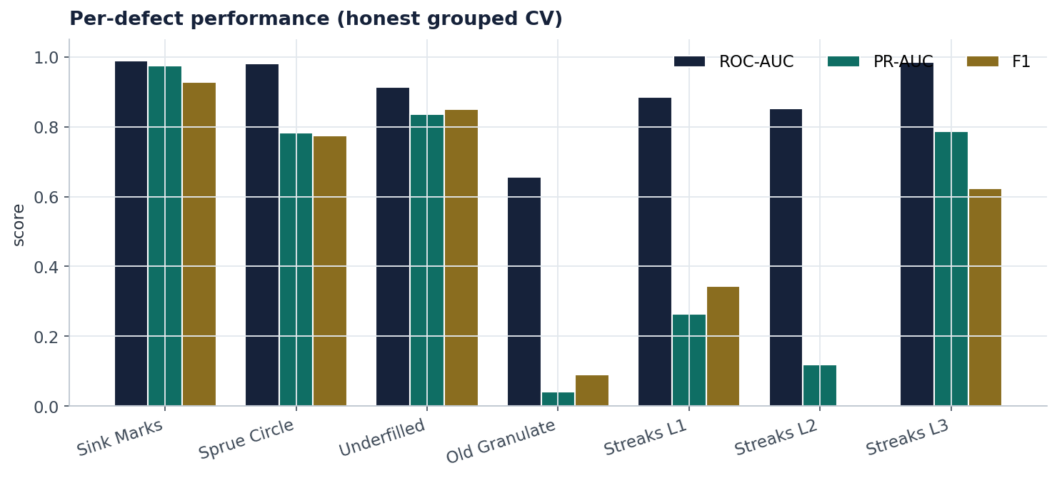
RESULTS
Strong on the Frequent, Actionable Defects
ROC-AUC on unseen settings. Rare defects (old granulate, streaks L1/L2) remain hard — reported honestly.

Slide 8
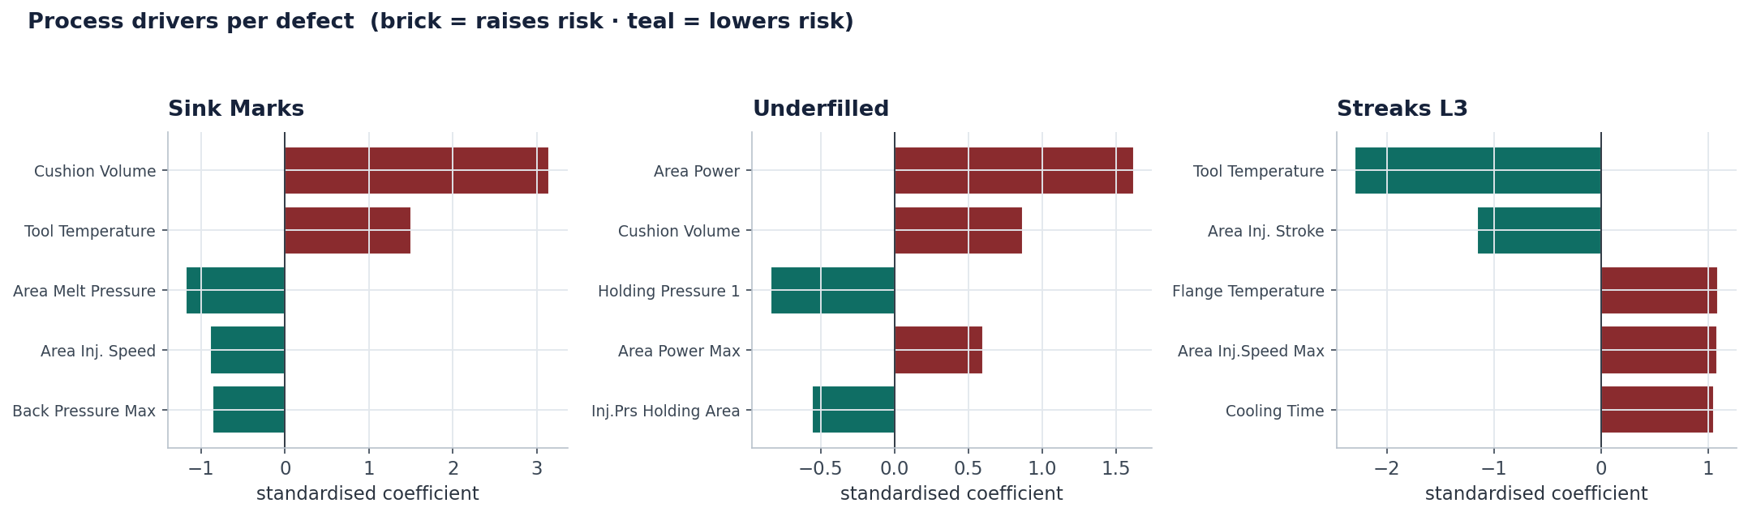
WHY IT WORKS
The Model Agrees with Injection-Moulding Physics
Sink Marks
Rise when packing is too weak — low holding pressure, large leftover cushion
Underfilled
Tracks the same packing deficit as sink marks
Streaks L3
Governed by injection speed and tool/flange temperature — too fast and too hot burns the polymer

Slide 9

FROM PREDICTION TO ACTION
Each Predicted Defect Maps to a Concrete Set-Point Change
Predicted Defect
Set-Point to Change
Action
Sink Marks
Holding Pressure 1
Increase
Sprue Circle
Holding Time
Increase
Underfilled
Holding Pressure 1
Increase
Streaks L1
Holding Pressure 1
Increase
Streaks L2
Holding Pressure 1
Decrease
Streaks L3
Tool Temperature
Increase
Old Granulate
Holding Pressure 1
Decrease (review)
Validated on the Real Data
6 of 7 rules confirmed; the rare one flagged. A transparent, auditable rule-base, each rule checked against the real experiments — not a black box.
Sink-mark rate vs holding pressure: low → high = 0.36 → 0.06
Raising holding pressure really does cut the fault — confirmed in the DoE.

Slide 10
CONCLUSION
Did We Get Good Results? Yes.
0.895
0.94
Honest Macro ROC-AUC
OK/NOK Gate
vs 0.978 leaky
F1 0.88
6/7
0
Rules Validated
Quality-Sensor Leakage
Counter-action rules confirmed
Deliberately excluded
Leakage-free, honestly evaluated, physically interpretable, with validated recommendations — and we even tried deep learning (a TCN), which did not beat the simple model at this data size.

Slide 11
CLOSING
Thank You!

